Slide 1
GNN Basics
Introduction to graph neural networks concepts

Slide 2
Introduction
Graph Neural Networks (GNNs) extend traditional neural networks by learning from graph-structured data, capturing relationships and features of nodes and edges for richer insights.

Slide 3

Introduction to Graph Neural Networks

Slide 4
Basics of Neural Networks and Graphs
Neural networks learn patterns from structured data like images and text, while graphs model complex relationships through nodes and edges, enabling analysis of irregular data.

Slide 5
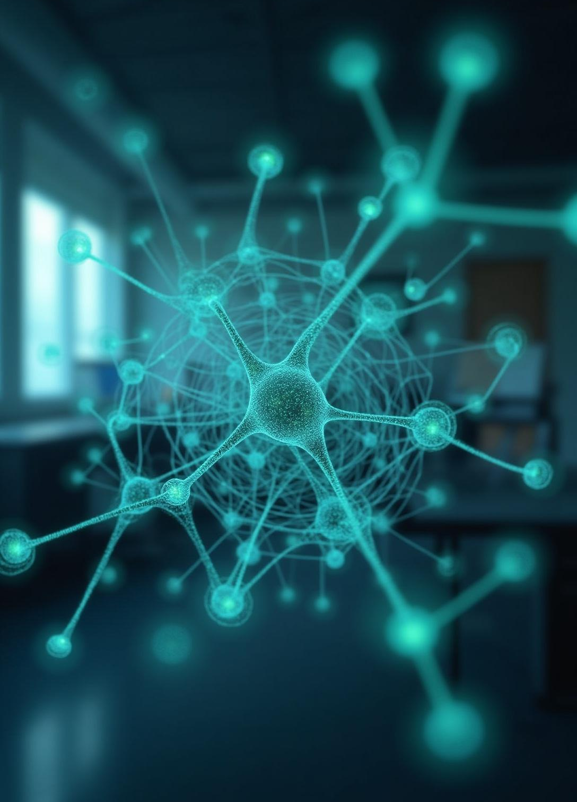
Definition and Importance of GNNs
GNNs leverage graph topology and node features to perform tasks such as node, edge, and graph-level predictions, crucial for applications in diverse fields like biology and social networks.

Slide 6
Comparison of Traditional NNs and GNNs
Traditional neural networks excel with grid-like data but struggle with irregular structures. Graph Neural Networks (GNNs) effectively process graph data by leveraging both node features and their relationships, providing enhanced modeling of complex interconnected information.

Slide 7

GNN Architecture and Applications

Slide 8

Message Passing Mechanism in GNNs
GNNs operate via message passing, where nodes aggregate information from neighbors, update embeddings through neural layers, and capture multi-hop relationships, enabling rich and context-aware node representations.

Slide 9
Popular GNN Models and Real-world Examples
Notable GNNs include GCN, GAT, and GraphSAGE, applied in diverse fields such as traffic prediction, recommendation systems, and brain network analysis, showcasing their versatility and effectiveness.

Slide 10
Use Cases in Social Networks and Molecular Biology
In social networks, GNNs support community detection, recommendations, and anomaly detection. In molecular biology, they aid drug discovery, protein interaction analysis, and personalized treatments, driving innovation in both domains.

Slide 11

Conclusions
Future GNN research focuses on enhancing scalability, supporting dynamic and heterogeneous graphs, improving explainability, and integrating with other AI fields, unlocking further potential for complex graph data analysis.

Slide 12
Thanks
Do you have any questions?
youremail@freepik.com
+00 000 000 000
yourwebsite.com
Please keep this slide for attribution

